Slide 1

Blockchain: State of the Art, Security Concerns and Future Applications
Group Members:
ABBA GARBA
Dalle nyame Yvonne Patricia
Ange, Herenui BOUMBA
Emahatsion Issac Tekle
Clara RHY Wang
董子宁

Slide 2
Overview of Blockchain Technology
Introduction
Technical overview
Types of Blockchains and their applications
Public Blockchains
Private Blockchains
Consortium Blockchains
Other form of Blockchains
Permissioned
Permissionless
Real world use cases
Security and Privacy concerns
Existing solutions to optimize current Blockchain technologies.
Conclusion

Slide 3
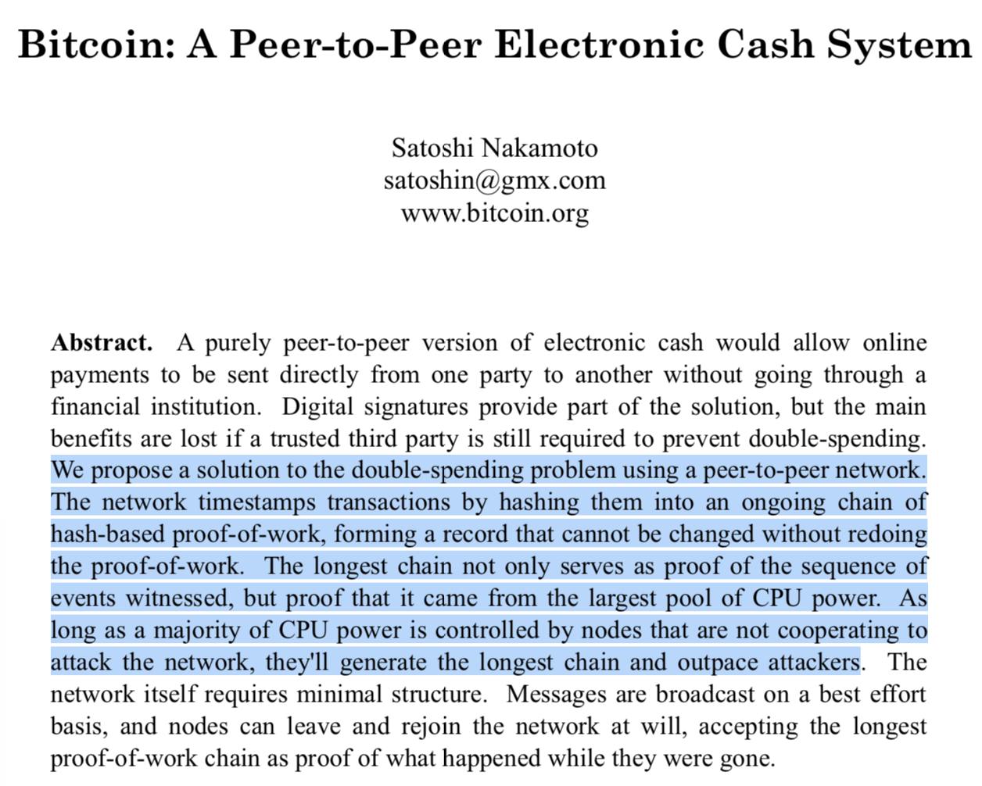
Introduction of Blockchain Technology
Virtual currency system without any trusted parties.
Participants without real identities.
Solve generals problem in a distributed systems (Byzantine).
Proposed a system which is hard to hack (Blockchain).
Automated contract (Smart contract)
“Bitcoin works in practice, but not in theory” (Bonneau, 2015).
Satoshi made a Break through by solving long-standing problem of double spending with out the need of a trusted authority.
Security and privacy challenges
Managing contracts execution
Notes:
The Bitcoin White Paper was published by Satoshi Nakamoto in 2008; the first Bitcoin block got mined in 2009. Since the Bitcoin protocol is open source, anyone could take the protocol, fork it (modify the code), and start their own version of P2P money. Many so-called altcoins emerged and tried to be a better, faster or more anonymous than Bitcoin. Soon the code was not only altered to create better cryptocurrencies, but some projects also tried to alter the idea of blockchain beyond the use case of P2P money.
Govt, Institutions, private sectors etc use the core idea of blockchain to buld a new systesm
“Bitcoin works in practice, but not in theory”.
Formal verification, software bugs, design the security and privacy
Bitcoin’s stability relies on an unknown combination of socioeconomic factors which is hopelessly intractable to model with sufficient precision, failing to yield a convincing argument for the system’s soundness.
The second viewpoint, contend that Bitcoin is filling an important niche by providing a virtual currency system without any trusted parties and without pre-assumed identities among the participants.
General problems in a distributed system is impossible bitcoin make it possible to achieve..
What is needed is an electronic payment system based on cryptographic proof instead of trust, allowing any two willing parties to transact directly with each other without the need for a trusted third party.
Consider two opposing viewpoints on Bitcoin in straw- man form. The first is that “Bitcoin works in practice, but not in theory.”
At times devoted members of the Bitcoin community espouse this philosophy and criticize the security research community for failing to discover Bitcoin, not immediately recognizing its novelty, and still today dismissing it due to the lack of a rigorous theoretical foundation.
A second viewpoint is that Bitcoin’s stability relies on an unknown combination of socioeconomic factors which is hopelessly intractable to model with sufficient precision, failing to yield a convincing argument for the system’s soundness.

Slide 4

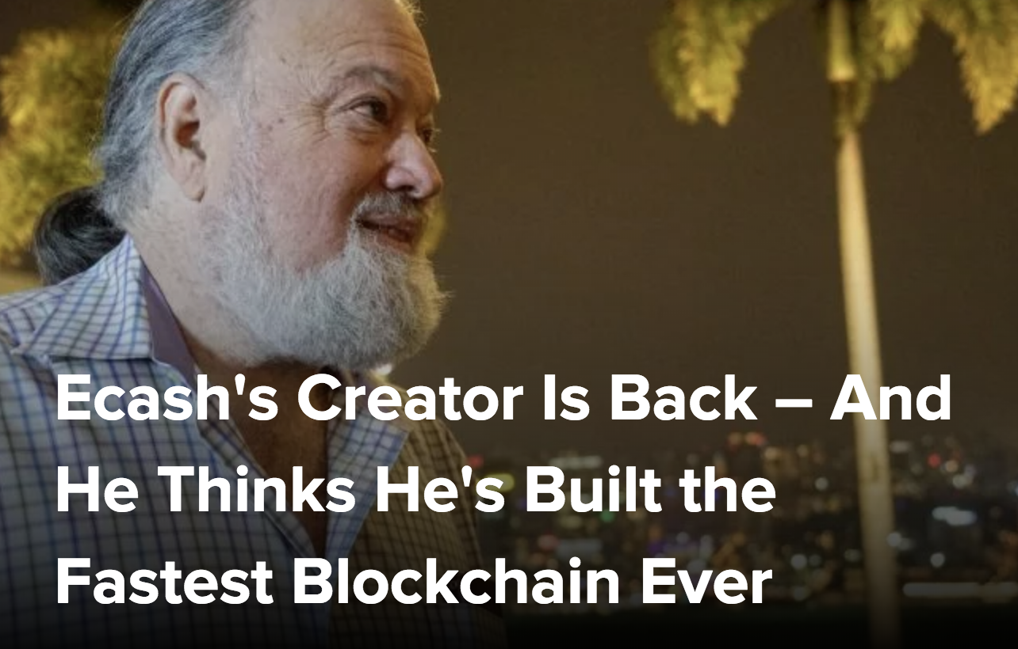



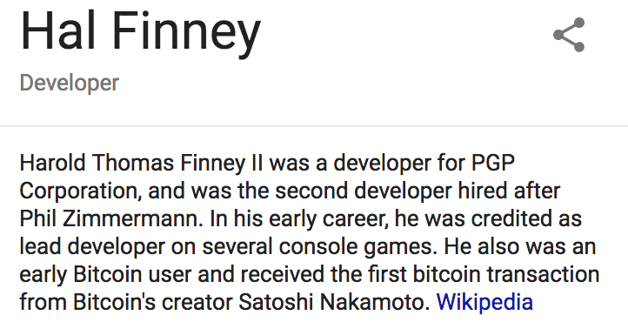



Who invented Blockchain?
Real Satoshi Behind Bitcoin?
Notes:
https://www.coindesk.com/ecashs-inventor-is-back-and-he-thinks-hes-built-the-fastest-ever-blockchain/
https://www.blockchaineconomy.com.au/learn-about-our-guest-speaker-phd-w-scott-stornetta/

Slide 5
Why Blockchain Technology Matters?
Decentralized, distributed and public digital ledger
Contains growing list of records called: Blocks
Block contains a transaction data and cryptographic hash of the previous block.
Managed by a peer-to-peer network and distributed time-stamping
Miners in the Blockchain validate new blocks.
Data is immutable
Decentralized consensus (POW/POS/DPOS).
Notes:
Blockchain was invented by Satoshi Nakamoto in 2008 to serve as the public transaction ledger of the cryptocurrency bitcoin.
A blockchain is a decentralized, distributed and public digital ledger that is used to record transactions across many computers so that the record cannot be altered retroactively without the alteration of all subsequent blocks and the collusion of the network.
It was implemented by Nakamoto as a core component of the cryptocurrency bitcoin
A blockchain is a continuously growing list of records, called blocks
Block typically contains a transaction data and cryptographic hash of the previous block,
blockchain is typically managed by a peer-to-peer network and distributed time stamping
Miners validate new blocks.
Blockchain is resistant to data modification
Decentralized consensus has therefore been achieved with a blockchain: (BFT).

Slide 6
Key essentials of blockchain technology
The use of cryptography
Time stamps
Peer to peer network
Anonymity and economic incentives
Distributed consensus
Figure 1: Key essentials of blockchain technology
Notes:
Without Cryptography bitcoin or blockchain not have existed
Public key cryptography. Bitcoin uses public key cryptography to handle transactions. This will be discussed in the rest of this chapter. Hash functions. Bitcoin uses hash functions to secure the information in the block- chain. This topic will be discussed in Chapter 7.
Symmetric key cryptography. Bitcoin uses symmetric encryption to protect the pri- vate keys in a user’s wallet. The use of symmetric encryption in the wallet software is not a requirement. However, its use is highly recommended. Symmetric-key cryptog- raphy will be covered in section 8.1.
The use of cryptography
Time stamps
Distributed consensus
Anonymity and economic incentives
Peer to peer network

Slide 7
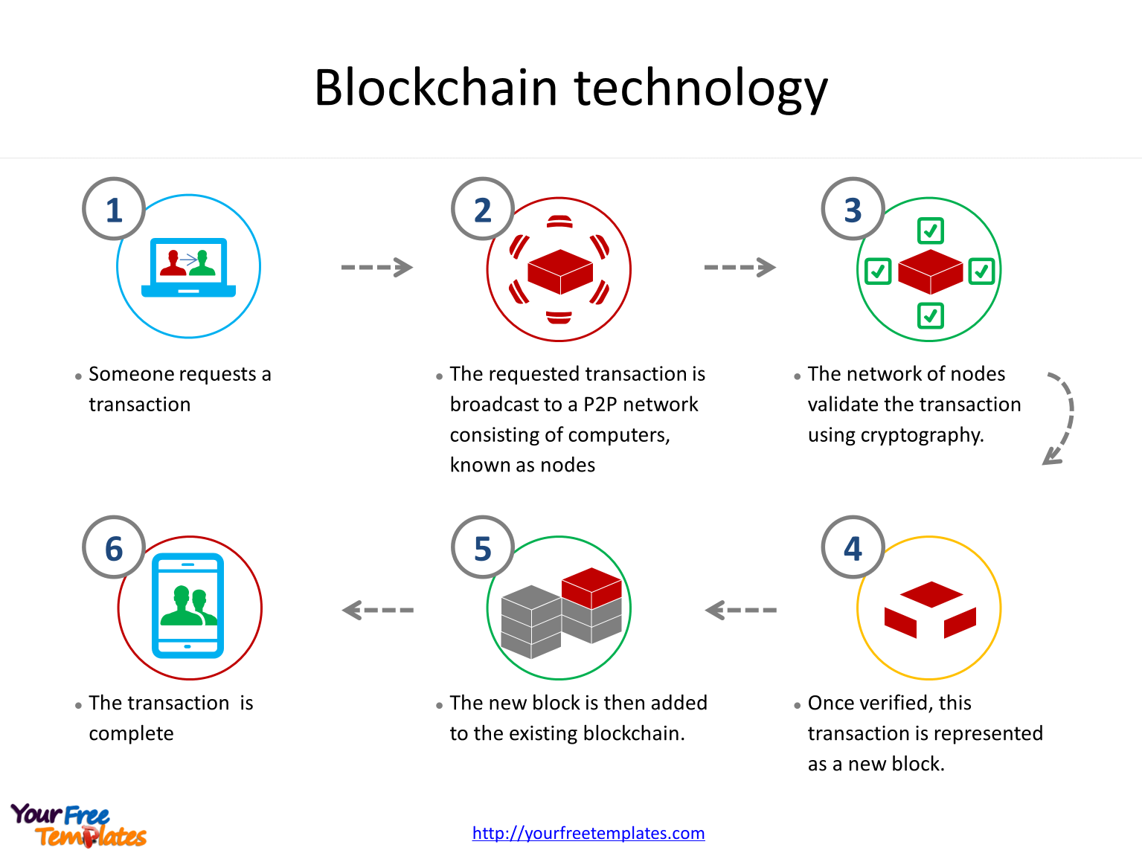
Transactions, Blocks, Mining, and the Blockchain
Figure 2: Transaction circle in Blockchain
Notes:
The blockchain is an ever-growing chain of blocks. Each block contains a group of new transactions and a link to the previous block in the chain. New transactions in the network are collected into a block which is appended to the blockchain. Note that old transactions are still in the blockchain: old blocks are never removed from the block- chain, thus the blockchain can only increase in length.
It is easy to adjust the block dif culty by increasing the number of starting zero bits. The Bitcoin protocol adjusts this dif culty to target 10 minutes between blocks. This dif- culty adjustment is part of the rules of Bitcoin and it is coded into every Bitcoin client.
The block dif culty is adjusted every 2,016 blocks or roughly every 2 weeks10. The adjustment takes into account the change in the computational power of the whole network since the last adjustment, by comparing the time-stamps of two blocks 2,016 positions apart. When mining power is being added to the network, blocks will be mined quicker than the target 10 minute period. The dif culty will be adjusted higher but trail- ing the growing network power.

Slide 8
How Blockchain Works
Unconfirmed Block/
Unordered Block Transactions
Txn abc1
Txn 804d
Txn abc1
Txn 3041
Txn 804d
Txn 749c
Txn 9407
New Block
Block# 5C4
Block# 5B4
prev# 8AC
Time
-Stamp
Block
Nonce
prev# 8AC
Time -Stamp
Block Nonce
Prev Block#99
Time-
Stamp
Blocknonce
txn 68e
txn 23d
txn 24c
txn……
txn 24c
txn…..
txn 77c
txn 78c
txn…..
txn 23c
txn 78c
txn…..
~10 min
~10 min
~10 min
Figure 3: How Blockchain works

Slide 9
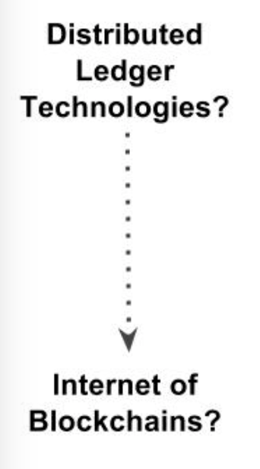
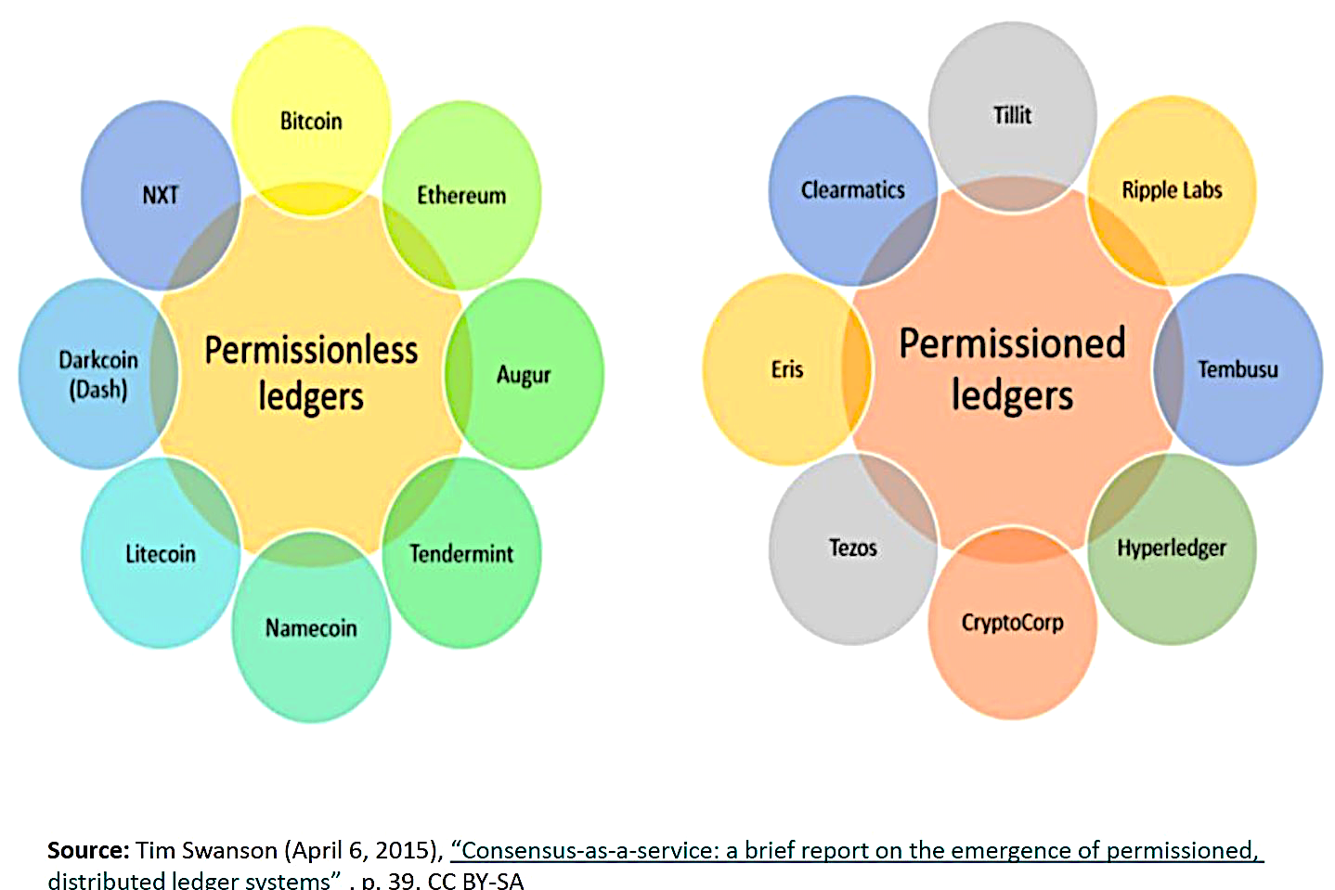
Types of Blockchain
Public Blockchains
Bitcoin
Ethereum
Litecoin
Neo
Other
Classification of Blockchains
Blockchains
Other uses cases
Private Blockchains
company internal
Federated Blockchains
R3
B31
EWF
Blockchain is suitable for recording value/ digital assets:
Medical records
Records management activities
Identity management
Transaction processing
Documenting provenance
Food traceability
E-voting.
Trade Processing and Settlement
Decentralizing social media: The Steemit case
The bitcoin design has inspired other applications
Figure 4: Types of Blockchain
Notes:
Public Blockchain
A public blockchain has absolutely no access restrictions
Offer economics incentives who spolve (POW)
Bitcoin and ethereum
Neo EOS
Private Blockchain
One cannot join it unless invited by the network administrators.
Participant and validator access is restricted
Consortium/ Federated
is permissioned but instead of a single organization controlling it
a number of companies might each operate a node on such a network.
The administrators of a consortium chain restrict users’ reading rights as they see fit and only allow a limited set of trusted nodes to execute a consensus protocol.
Permissionless Blockchain: Every node in the network participate in consensus procedure, e.g. Bitcoin Blockchain (Proof of Work)
Permissioned Blockchain: Only Selected nodes(validators, e.g. Government or trusted nodes) participate in consensus procedure e.g. Hyperledger Blockchain

Slide 10
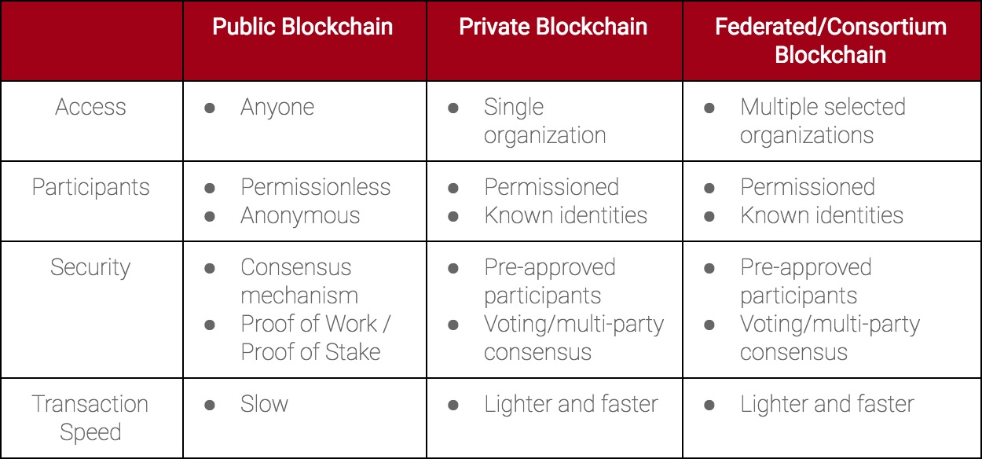
Types of Blockchain
Table 1: Table indicate Blockchain types and their core features

Slide 11
Why the net giants are worried about the Web 3.0
Source: The Internet of Blockchains Foundation (2018).
Notes:
The Web 3.0 ecosystem already consists of over 3000 variegated crypto coins and over 900 decentralized apps or DApps (a single DApp can mean a team of up to 50 members, each dedicated to disrupting a specific industry). And even though the industry is still in its infancy, the market cap has already exceeded 800 billion.

Slide 12
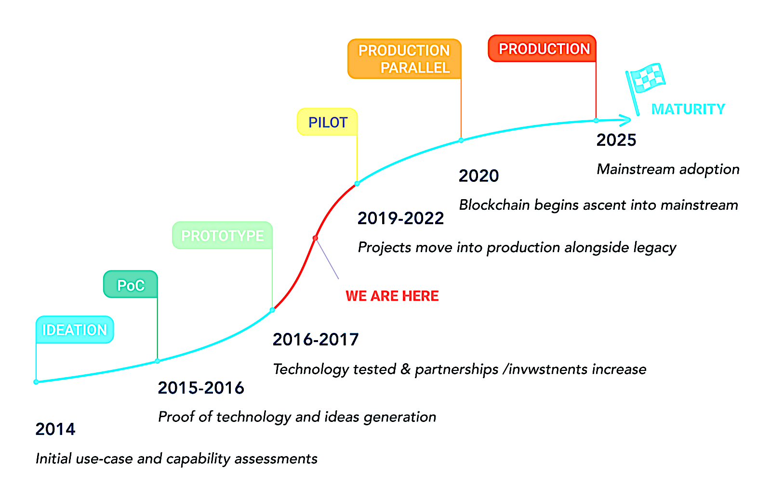
Blockchain Maturity Model
A WEF predicted that by 2025 10% of global GDP would be stored on blockchains technology (Forbes, 2016).
“Blockchain has the potential to create new foundations for our economic and social systems” (HBR, 2017).
Source: H Wang (2016)
Figure 5: Maturity Model of Blockchain
Notes:
A World Economic Forum report from September 2015 predicted that by 2025 ten percent of global GDP would be stored on blockchains technology.^{[160][161]}
In early 2017, Harvard Business School professors Marco Iansiti and Karim R. Lakhani said the blockchain is not a disruptive technology that undercuts the cost of an existing business model, but is a foundational technology that "has the potential to create new foundations for our economic and social systems". They further predicted that, while foundational innovations can have enormous impact, "It will take decades for blockchain to seep into our economic and social infrastructure."^{[8]}

Slide 13
Blockchain Strengths, Weaknesses, Opportunities and Threats (SWOT).
Strengths | Weaknesses
Distributed resilience and control Decentralized network Open source Security and modern cryptography Native asset creation Asset provenance Dynamic and fluid value exchange | Lack of ledger interoperability Customer unfamiliarity and poor user experience Lack of hardened/tested technology limitation Smart contract code of programing model Wallet and key management Poor developer user experience skills scarcity Immature scalability Lack of trust in new technology suppliers
Opportunities | Threats
Reduced transaction costs Business process acceleration and efficiency Reduced fraud Reduced system risk Monetary democratization New business-model enablement Application rationalization and redundancy | Legal jurisdictional barriers Politics and hostile notion state actors Technology failures Institutional adoption barriers Divergent blockchain Ledger conflicts/competition Poor governance
Table 2: Blockchain (SWOT) Source: Niranjanamurthy (2018 )

Slide 14
Security challenges of blockchain technology
Block001
Block002
Block002
Block008
Block003
Block004
Block007
Block005
Block006
Block007
Block005
Block006
Proof-of-work is use to secure public blockchains e.g Bitcoin and Ethereum
Fork in the blockchain
Orphan blocks ignored by the network
Long chains wins, all the nodes switch to it
Figure 6: Dynamics of Blockchain
Notes:
Block difficult
Target 10 minutes between blocks
Mining rewards
Coinbase
Genesis Blockchain
A fork occurs when Blocks found at the same times by miners

Slide 15
Smart contract Vulnerabilities
What is Smart Contract?
Smart contracts: are computer programs that can be correctly executed by a network of mutually distrusting nodes, without trusted authority.
Handle transfer of assets
Smart contracts are stored on a blockchain (immutable).
Managing the contract execution led to severe security challenges (stealing or tampering the assets)
Smart Contracts rely on a non-standard software life-cycle (Luu, 2017)
Handling updates or bugs (Software update)
E.g a wallet application freeze (500K Ethers~150M USD), in Nov. 2017.
The DAO (∼ $150M ) June, 2016.
An attacker managed to put ∼ $60M under her control, until the hard-fork of the blockchain nullified the effects of the transactions involved in the attack (Hamida, 2017).
Notes:
Smart contracts are computer programs that can be correctly executed by a network of mutually distrusting nodes, without the need of an external trusted authority.
Handle transfer of assets
Since smart contracts are stored on a blockchain, they are immutable, public and decentralized.
Managing the contract execution led to severe security challenges which aim at stealing or tampering the assets.
Smart Contracts rely on a non-standard software life-cycle
Handling updates or bugs due to releasing a new version of the software
E.g a wallet application, causing the freezing of about 500K Ethers (about 150M USD, in November 2017).
The DAO [14] was a contract implementing a crowd-funding platform, which raised ∼ $150M before being attacked on June 18th, 2016.
An attacker managed to put ∼ $60M under her control, until the hard-fork of the blockchain nullified the effects of the transactions involved in the attack.
We analyse a case of study where a bug discovered in a Smart Contract library, and perhaps "unsafe" programming, allowed an attack on Parity, a wallet application, causing the freezing of about 500K Ethers (about 150M USD, in November 2017). In this study we analyze the source code of Parity and the library, and discuss how recognised best practices could mitigate, if adopted and adapted, such detrimental software misbehavior. We also reflect on the specificity of Smart Contract software development, which makes some of the existing approaches insufficient, and call for the definition of a specific Blockchain Software Engineering.
We analyse a case of study where a bug discovered in a Smart Contract library, and perhaps "unsafe" programming, allowed an attack on Parity, a wallet application, causing the freezing of about 500K Ethers (about 150M USD, in November 2017). In this study we analyze the source code of Parity and the library, and discuss how recognised best practices could mitigate, if adopted and adapted, such detrimental software misbehavior. We also reflect on the specificity of Smart Contract software development, which makes some of the existing approaches insufficient, and call for the definition of a specific Blockchain Software Engineering.

Slide 16
Attacks and Counter Measures
Attack | Description | Primary targets | Adverse effects | Possible countermeasures
Double spending attacks | coins in multiple transactions, send two conflicting transactions in rapid succession | sellers or merchants | sellers lose their products, drive away the honest users from network, creates blockchain forks | inserting observers in the network, communicating double spending alerts among peers , nearby peers should notify the merchant about an ongoing double spend as soon as possible, merchants should disable the incoming connections.
> 50% hashpower or Goldfinger | adversary controls more than > 50% of computational power in the Bitcoin network | Bitcoin miners, exchange and users network, Bitcoin centers, | drive away the miners working alone or within small mining pools, weakens the effectiveness of consensus protocol, DoS | inserting observers in the network, communicating double spending alerts among peers, disincentivize large mining pools.
Eclipse or net-split | adversary monopolizes all of the victim’s incoming and outgoing connections | miners and users | inconsistent view of the network/block chain at the attacked node, enable double spends with more than one confirmation | use whitelists, disabling incoming connections.
Smart contract Vulnerabilities | Course a wallet application freeze, adversary can manipulate smart contract execution to gain profit. Improper execution of contracts. | Participants in the contract. | Causing the freezing huge amount of Eth | Formal verification tools such as: Oyente to find potential security bugs.
Table 3: Attacks and Counter Measures Source: Mauro Conti (2017).
Notes:
Other form of attacks
Block with holding attacks
Security of Wallets
Security of Software
Race attack
Finney Attack
Exchange Platform

Slide 17
Privacy and Anonymity
In Bitcoin and smart contracts entire transactions are stored in public ledger (Data privacy)
–Users privacy hidden behind pseudonymous (i.e., public keys)
–Smart contract transaction (Data flow in a contracts)
Meta data in the Private Blockchain is crucial (Competitors)
The public verifiability of pseudonymous transactions in Blockchain is vulnerable :
–De-anonymization Attack
–Traceability
–Linkability
–IP address monitoring nodes
–web-spidering
Balances held by each address can be exposed and readily available (UTXO).
There is possibility of transaction graph analysis
“Bitcoin is a secure and anonymous digital currency” (Wikileaks).
“Bitcoin won’t hide you from the NASA’s prying eyes” (Wired, UK).
Notes:
“Bitcoin is a secure and anonymous digital currency” (Wikileaks)
“Bitcoin won’t hide you from the NASA’s prying eyes” (Wired, UK)
Public Blockchain privacy arises from pseudonymous addresses (i.e., public keys)
Meta data in the Private Blockchain is crucial (Competitors)
Smart contract transaction execution in every node (what inputs and output flowing to a contract)
In Blockchain applications such as Bitcoin and smart contracts entire transactions are stored in public.
Although, information about users in the transactions only included the addresses.
Users privacy hidden behind pseudonymous
The public verifiability of their pseudonymous transactions makes the Blockchain highly vulnerable to a variety of:
Traceability
Linkability
De-anonymization Attack
IP address monitoring nodes
web-spidering
Balances held by each address can be exposed and readily available just by querying the UTXO.
There is possibility of transaction graph analysis
Addresses can be linked to one another by observing the transactions between them.
Deanonymization
transaction graph analysis
To de-anonymize, the adversary must take the further step of linking address clusters to real-world identities.
however it quickly became clear that due to the public nature of the blockchain it is sometimes possible to trace the flow of money between pseudonyms and conclude that they are likely controlled by the same individual.
Network de-anonymization.
The other major target of de-anonymization efforts is the peer-to-peer network. Nodes leak their IP address when broadcasting transactions. Us- ing an anonymity network is therefore crucial for privacy.
In Blockchain applications such as Bitcoin and smart contracts entire transactions are stored in public.
Although, information about users in the transactions only included the addresses.
Users privacy hidden behind pseudonymous
The public verifiability of their pseudonymous transactions makes the Blockchain highly vulnerable to a variety of:
Traceability
Linkability
De-anonymization Attack
Balances held by each address can be exposed and readily available just by querying the UTXO.
There is possibility of transaction graph analysis
Addresses can be linked to one another by observing the transactions between them
The transaction graph is a graph where Bitcoin transactions are placed at the vertices, and the edges connect a with associated (TxIn) and (TxOut).
Graph analysis is a framework used to de-anonymize users’ identities:
Scraped bitcoin
Forum users
Bitcoin transaction information
Integrate off-network information
Attackers can combine the information gained through network analysis with other information e.g ID of donation address, exchange or online wallet services
Integrate IP traffic
Observe the IP traffic of the Bitcoin network she can associate Bitcoin users with IP addresses.
Network topology
Adversaries can infer from the user graph to get some relevance information that can leak user privacy e.g : graph connectivity.
Cluster analysis
A clustering of the behavior of the vertices in the user graph can help further reduce the size of the user graph, by better identifying users.
Flow and temporal analysis
Large flows of funds can be traced through the user network.
Graph isomorphism with other social networks.
Attacker combine user graph with social network information to link users.

Slide 18
Mixing Technique
Alice1: 1
Alice2: 1
Mix2: 1
Bob1: 1
Mix1: 1
Bob2: 1
Mix3: 1
Carol1: 1
Carol2: 1
Users to send their funds to a central pool and later retrieve the funds to a different Bitcoin address.
These services combine the inputs of many users so that the outputs are difficult to trace back to the inputs.
Drawback
Delay between the deposit and the withdrawal.
vulnerable to Sybil attacks
Lack of trust from the operator
Notes:
Laundries usually introduce a delay between the deposit and the withdrawal, waiting for enough transactions to accumulate in the meantime.
Laundry services are more efficient when the number of users and the volume of transactions are high.
However, laundry services are vulnerable to Sybil attacks,
Another problem of laundries is that they require trust in the operator
It is very easy for this operator to steal users’ funds, just by receiving inputs into the laundry and never redeeming them.

Slide 19
Comparison of different Privacy enhancing Schemes
Proposals | Type/Class | Distinct features and properties | Advantages | Disadvantages
ConJoin | P2P | uses multi-signature transactions to enhance privacy | Prevent thefts, lower transaction fee | anonymity level depends on the number of participants, vulnerable to DoS, Sybil and intersection attacks, prevents plausible deniability
CoinShuffle | P2P | decentralized protocol for coordinating CoinJoin transactions through a cryptographic mixing protocol | internal unlinkability, robust to DoS attacks, theft resistance | lower anonymity level and deniability, prone to intersection and sybil attacks
Xim | P2P | anonymously partnering and multi- round mixing | distributed pairing, internal unlink- ability, thwarts Sybil and DoS at- tacks | higher mixing time
Dandelion | P2P | networking policy to prevent network-facilitated deanonymization of Bitcoin users | provides strong anonymity even in the presence of multiple adversaries | vulnerable to DoS and sybil attacks
SecureCoin | P2P | based on CoinParty concept, an efficient and secure protocol for anonymous and unlinkable Bitcoin transactions | protect against sabotage attacks, at- tempted by any number of participating saboteurs, low mixing fee, deniability | vulnerable to DoS attacks, limited scalability
Table 4: Privacy Enhancing Schemes 1
Source: Mauro Conti (2017).
Notes:
CoinSwap:
bring third in the tx’s so that payer and payee can’t be linked.
Mixcoin:
It facilitate anonymous payments in Bitcoin and similar crypto currencies, adding an accountability mechanism to expose theft.
CoinJoin:
several users agreed to create single transactions
zerocoin:
cryptographic accumulator with zk-f inclusion to implement global currency to tackle some privacy challenges by unlinking Tx to payment origin.
Zerocash-zk-SNARKs
to hides payment origin destination and transfer amount.
CryptoNote-monero -Use ring signature for untraceable transaction
Stealth addresses
Allow receiver to create seed to generate address.
Sender then make payment to address derive from that seed while attacker can’t associate final address with publish seed.
Coinshffle

Slide 20
Comparison of different Privacy enhancing Schemes
Proposals | Type/Class | Distinct features and properties | Advantages | Disadvantages
BlindCoin | Distributed | based on MixCoin concept, uses blind signature scheme to ensure anonymity | internal unlinkability, DoS and Sybil resistance | partial theft resistance, additional costs and delays in mixing process
TumbleBit | Distributed | unidirectional unlinkable payment hub that uses an untrusted intermediary | prevents theft, anonymous, resists intersection, Sybil and DoS, scalable (implemented with 800 users) | normal payment using TumbleBit needs at least two sequential trans- actions
ZeroCoin / Zero- Cash | Altcoin | a cryptographic extension to Bit- coin , unlinkable and untraceable transactions by using zero knowledge proofs | provides internal unlinkability, theft and DoS resistance | relies on a trusted setup and non- falsifiable cryptographic assumptions, blockchain pruning is not possible
CryptoNote | Altcoin | relies on ring signatures to provide anonymity | provides strong privacy and anonymity guarantees | higher computational complexity, not compatible with pruning
MimbleWimble | Altcoin | a design for a cryptocurrency with confidential transactions | CT compatibility, improve privacy, fungibility and scalability | vulnerable to DoS attacks, not compatible with smart contracts
ByzCoin | Altcoin | Bitcoin-like cryptocurrency with strong consistency via collective signing | lower consensus latency and high transaction throughput, resistance to selfish and stubborn mining , eclipse and delivery- tampering and double-spending attacks | vulnerable to slow down or DoS attack and 51% attack.
Table 5: Privacy Enhancing Schemes 2
Source: Mauro Conti (2017).

Slide 21
Innovation and Future Blockchain Applications
Blockchain in IOT and AI
Asset management
Insurance
Supply chain management
Health care
Cloud storage
Food and provenance
Identity Management
Entertainment, Music, IP, Energy etc.

Slide 22
Thanks for your time!

Slide 23
References
Eyal, I. and Sirer, E.G., 2014, March. Majority is not enough: Bitcoin mining is vulnerable. In International conference on financial cryptography and data security (pp. 436-454). Springer, Berlin, Heidelberg.
Satoshi Nakamoto (2009)Bitcoin: A Peer-to-Peer Electronic Cash System
Conti, M., Kumar, S., Lal, C. and Ruj, S., 2018. A survey on security and privacy issues of bitcoin. IEEE Communications Surveys & Tutorials.
Bonneau, J., Miller, A., Clark, J., Narayanan, A., Kroll, J.A. and Felten, E.W., 2015, May. Sok: Research perspectives and challenges for bitcoin and cryptocurrencies. In Security and Privacy (SP), 2015 IEEE Symposium on (pp. 104-121). IEEE.
Marr, B., 2016. How Blockchain Technology Could Change The World. Forbes, May, 27.
Harvard Business Review (2017)
Niranjanamurthy, M., Nithya, B.N. and Jagannatha, S., Analysis of Blockchain technology: pros, cons and SWOT. Cluster Computing, pp.1-15.
Wang, H., Chen, K. and Xu, D., 2016. A maturity model for blockchain adoption. Financial Innovation, 2(1), p.12.
Hamida, E.B., Brousmiche, K.L., Levard, H. and Thea, E., 2017, July. Blockchain for Enterprise: Overview, Opportunities and Challenges. In The Thirteenth International Conference on Wireless and Mobile Communications (ICWMC 2017).
Luu, L., Chu, D.H., Olickel, H., Saxena, P. and Hobor, A., 2016, October. Making smart contracts smarter. In Proceedings of the 2016 ACM SIGSAC Conference on Computer and Communications Security (pp. 254-269). ACM.
Li, X., Jiang, P., Chen, T., Luo, X. and Wen, Q., 2017. A survey on the security of blockchain systems. Future Generation Computer Systems.
Atzei, N., Bartoletti, M. and Cimoli, T., 2017, April. A survey of attacks on Ethereum smart contracts (SoK). In International Conference on Principles of Security and Trust (pp. 164-186). Springer, Berlin, Heidelberg.
Karame, G.O., Androulaki, E. and Capkun, S., 2012, October. Double-spending fast payments in bitcoin. In Proceedings of the 2012 ACM conference on Computer and communications security (pp. 906-917). ACM.
Bravecoin (2018) https://bravenewcoin.com/news/more-51-blockchain-attacks-expected/
Wired UK, (2017)
Weakileaks, (2018)

